Slide 1

Chord-based DHT
ÁLVARO ALBERO GRAN
TYLER JONES
SEAN McBride
Naim Merheb

Slide 2
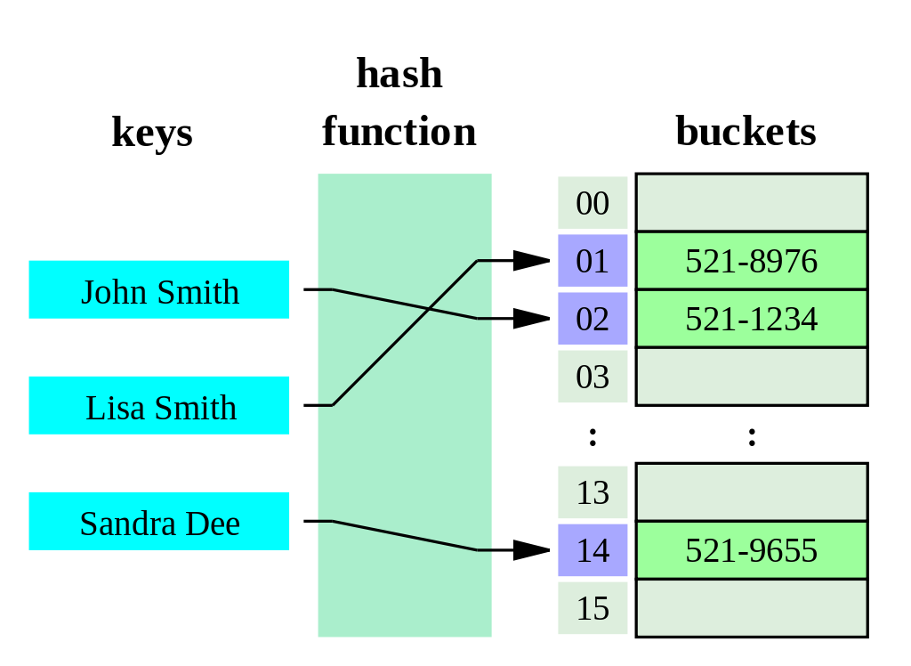
Hash Table
Source https://en.wikipedia.org/wiki/Distributed_hash_table

Slide 3
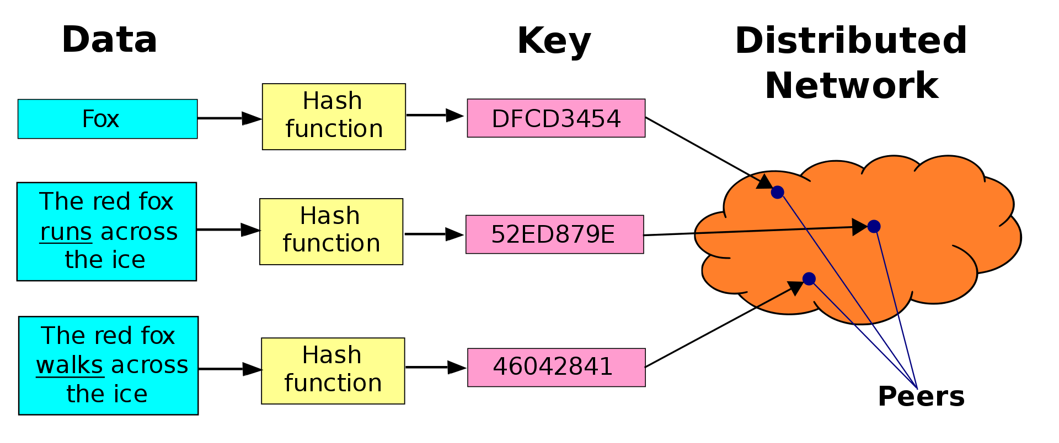
Distributed Hash Table
Source https://en.wikipedia.org/wiki/Distributed_hash_table

Slide 4
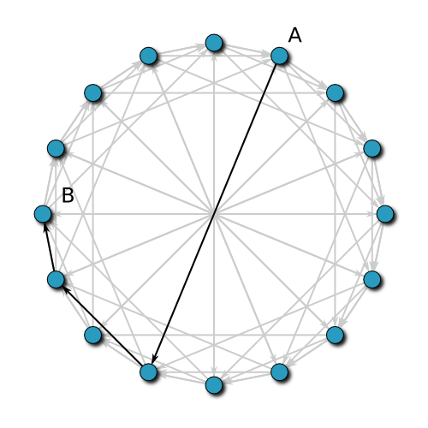
Chord Overview
A peer-to-peer distributed hash table.
Developed by Ion Stoica, Robert Morris, David Karger, Kaashoek, and Hari Balakrishnan from MIT
Keys and IP addresses are hashed into a uniform identifier space (typically using SHA-1)
The keys of the distributed hash table are stored on their closest successor node.
Forms a logical ring with “finger tables” to reduce access time
Source: https://en.wikipedia.org/wiki/Chord_(peer-to-peer)

Slide 5



Major Design Decisions
Software Components
Node.js, our “least common denominator” language
gRPC, a modern and popular RPC framework
@grpc/proto-loader, a library capable of dynamically loading gRPC protobuf files
grpc-caller, a third-party gRPC library that simplified use of async/await syntax
vis-network, a data visualization library for graph data structures
Collaboration Tools / Methodologies
Git and GitHub
Screen sharing via Blackboard Collaborate
Mob Programming via Visual Studio Code “Live Share”

Slide 6
Results
Complete
Not yet complete
Nodes able to join cluster
Able to lookup successor
Nodes run in actual processes and form a distributed system with a real-world RPC framework
Downloaded and cleaned k-v store data from StackOverflow
Clean and refactor JavaScript source code.
Implement SHA-1 hashing
Troubleshoot and allow nodes to leave Chord cluster
Seed Chord cluster with StackOverflow data
Ensure data migrates as expected as nodes join or leave the cluster
Build CRUD web app to view, modify, delete StackOverflow user data and validate system transparency
Deploy to AWS or Azure
Enhance Admin Interface to allow scaling of Chore nodes up and down

Slide 7
Demo
Start first Node
Grow Cluster
Watch Chord Ring Grow

Slide 8
Next steps!
Clean and refactor JavaScript source code.
Implement SHA-1 hashing
Troubleshoot and allow nodes to leave Chord cluster
Seed Chord cluster with StackOverflow data
Ensure data migrates as expected as nodes join or leave the cluster
Build CRUD web app to view, modify, delete StackOverflow user data and validate system transparency
Deploy to AWS or Azure
Enhance Admin Interface to allow scaling of Chore nodes up and down
Stretch goals: Replication, TypeScript, Shift SHA-1 Hashing to Worker Thread

